Slide 1


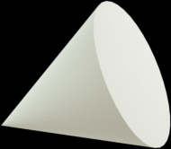


Bits & Bytes Coders
Kartik Arora
Gaurav Verma
Vedant Verma

Slide 2
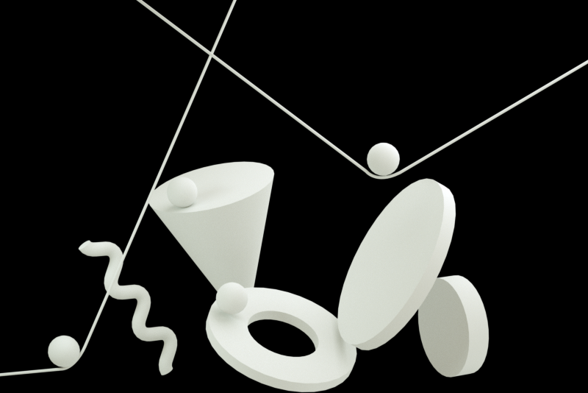

Problem Statement
ANDROID DEVELOPMENT:
Building a language learning app with practice exercises.

Slide 3
Language Learning app? Isn’t this the era of owl mascot?

Slide 4
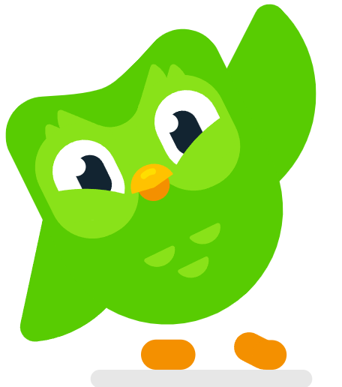

Slide 5
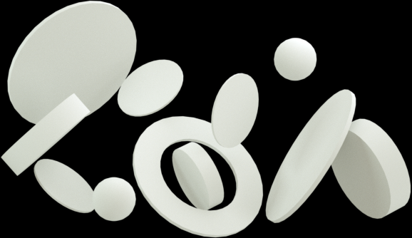
SignLearn
Learn american sign language at the comfort of home

Slide 6
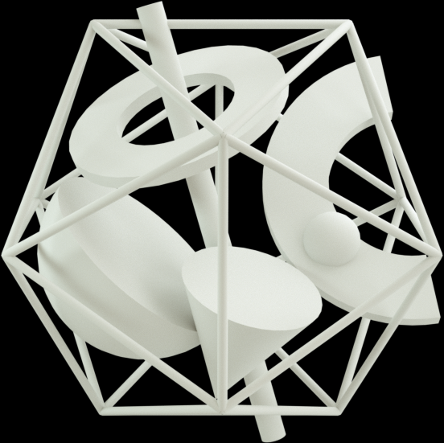
What is ASL
Sign language is a complete and complex way of communicating that uses hand gestures, facial expressions, and body language to convey meaning. It's not just a series of gestures representing spoken words, but a full-fledged language with its own grammar and syntax.

Slide 7
The Need for Sign Language
it's a great workout for your brain. It immediately breaks the communication barrier and allows you to be a better friend, colleague, lover, and family member to deaf people around you. Even if you don't become proficient, it's the effort that goes a long way.

